Slide 1



FINANCIAL PLANNING HUB
Team-01

Slide 2



01
Introduction
The Financial Planning Hub is a simple and user-friendly web application built with Streamlit to help users manage their expenses and plan their finances easily.
•It lets users track their spending, update or delete expenses, and generate clear financial reports.
•The app provides interactive charts and visuals to show spending patterns, making it easy to understand your finances.
•Designed for anyone, it makes managing money simple, quick, and accessible.

Slide 3
02
Project Overview
Administrator Features
•Manage Users: View and update user accounts and activities.
•Monitor Expenses: Review and oversee user expense data.
•Generate Reports: Create and export detailed financial reports.
•System Oversight: Ensure smooth operation and troubleshoot issues.
•Data Security: Backup data and manage access permissions.
Update Features: Modify and configure system settings as needed

Slide 4
02
Project Overview
Customer Features
1.User Authentication: Easy registration, login, and logout.
2.Expense Management: Add, update, delete, and view expenses.
3.Financial Reports: Generate reports with charts and export them as PDFs.
4.Dashboard: View spending insights at a glance.
5.Interactive Interface: Simple and user-friendly design for ease of use.

Slide 5
03
Milestone
Milestone 1: User Authentication and Expense Management
Implemented secure user registration, login, and logout features. Developed expense management functionalities to add, update, delete, and view expenses. Validated forms and wrote test cases for authentication and expense services.
Milestone 2: Financial Reporting
Created a reporting interface to generate expense summaries with totals and averages. Visualized spending patterns using charts and graphs and added PDF export functionality. Ensured accuracy with validations and test cases.

Slide 6
03
Milestone
Milestone 3: Dashboard and Visualization
Built a user dashboard displaying financial metrics with interactive charts and filters. Enabled real-time updates and responsive design for seamless usage across devices. Tested all dashboard components.
Milestone 4: Budget Planning and Alerts
Added budget planning with alerts for overspending. Implemented budget vs. actual comparisons and financial goal tracking. Ensured smooth functionality with error handling and thorough testing.

Slide 7
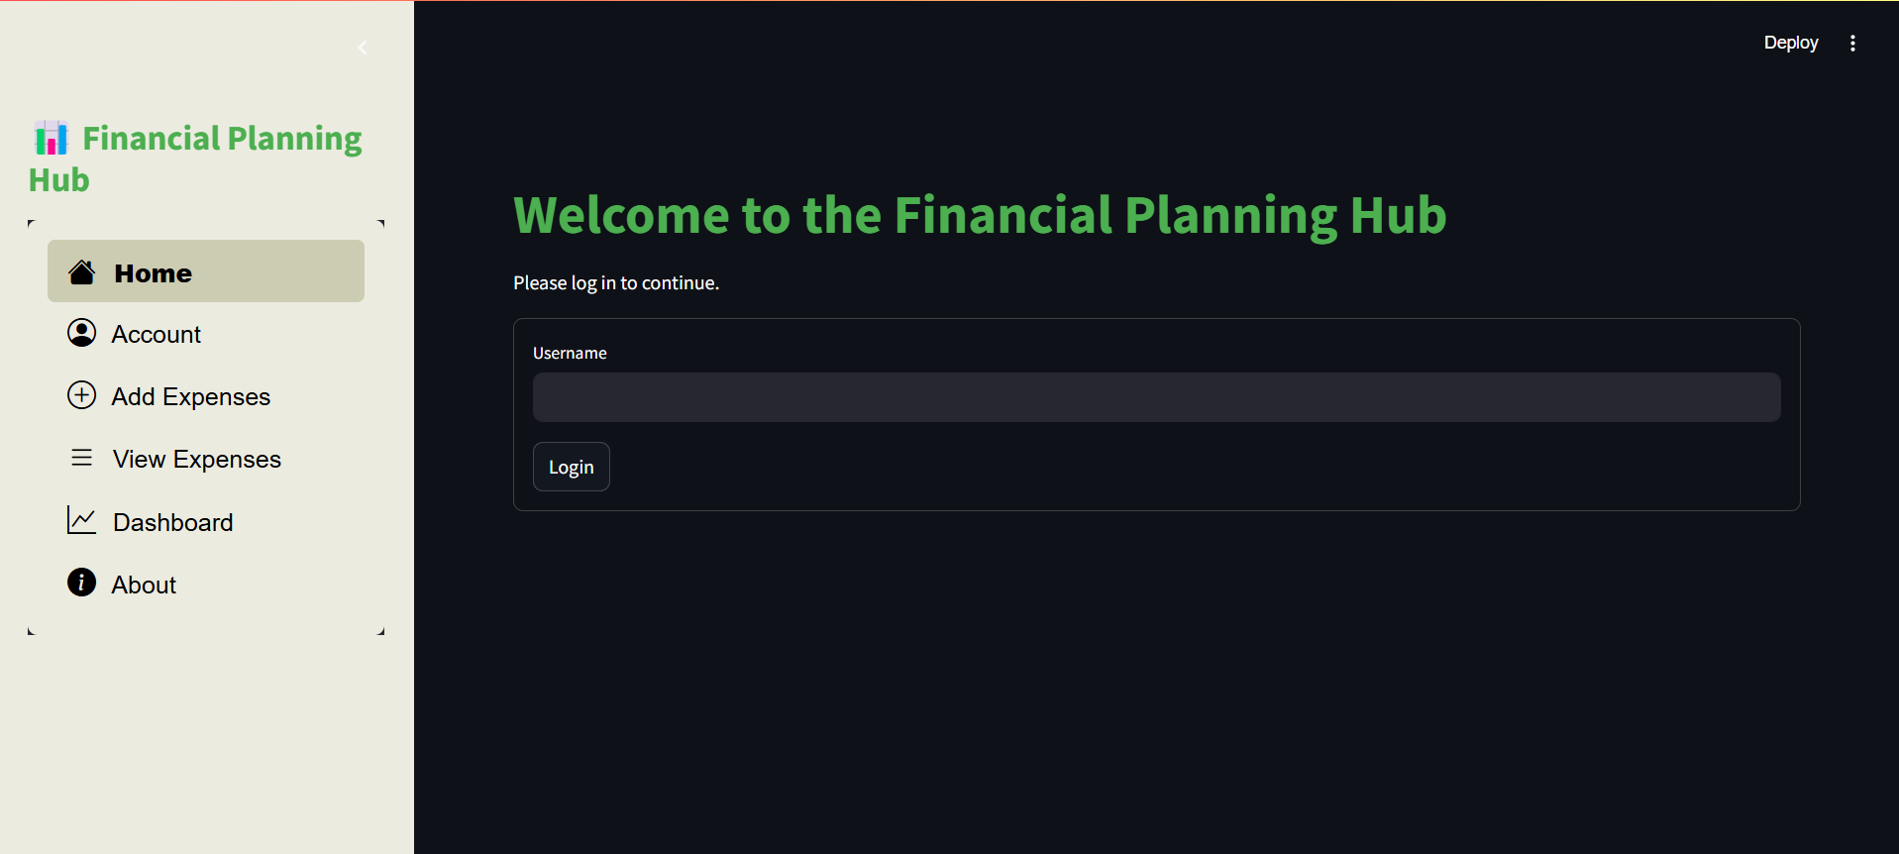
04
Project Snapshot
Home Page

Slide 8
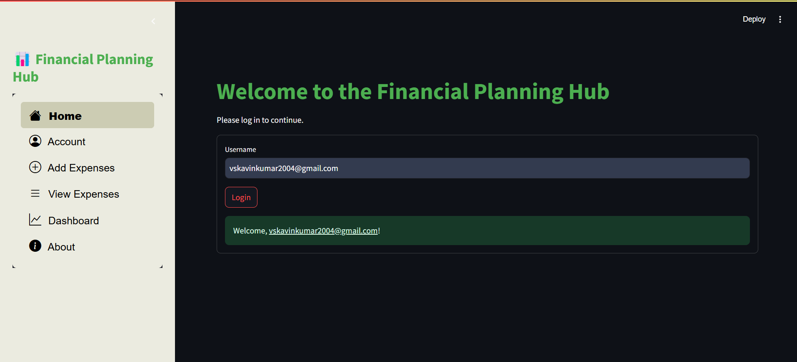
04
Project Snapshot

Slide 9
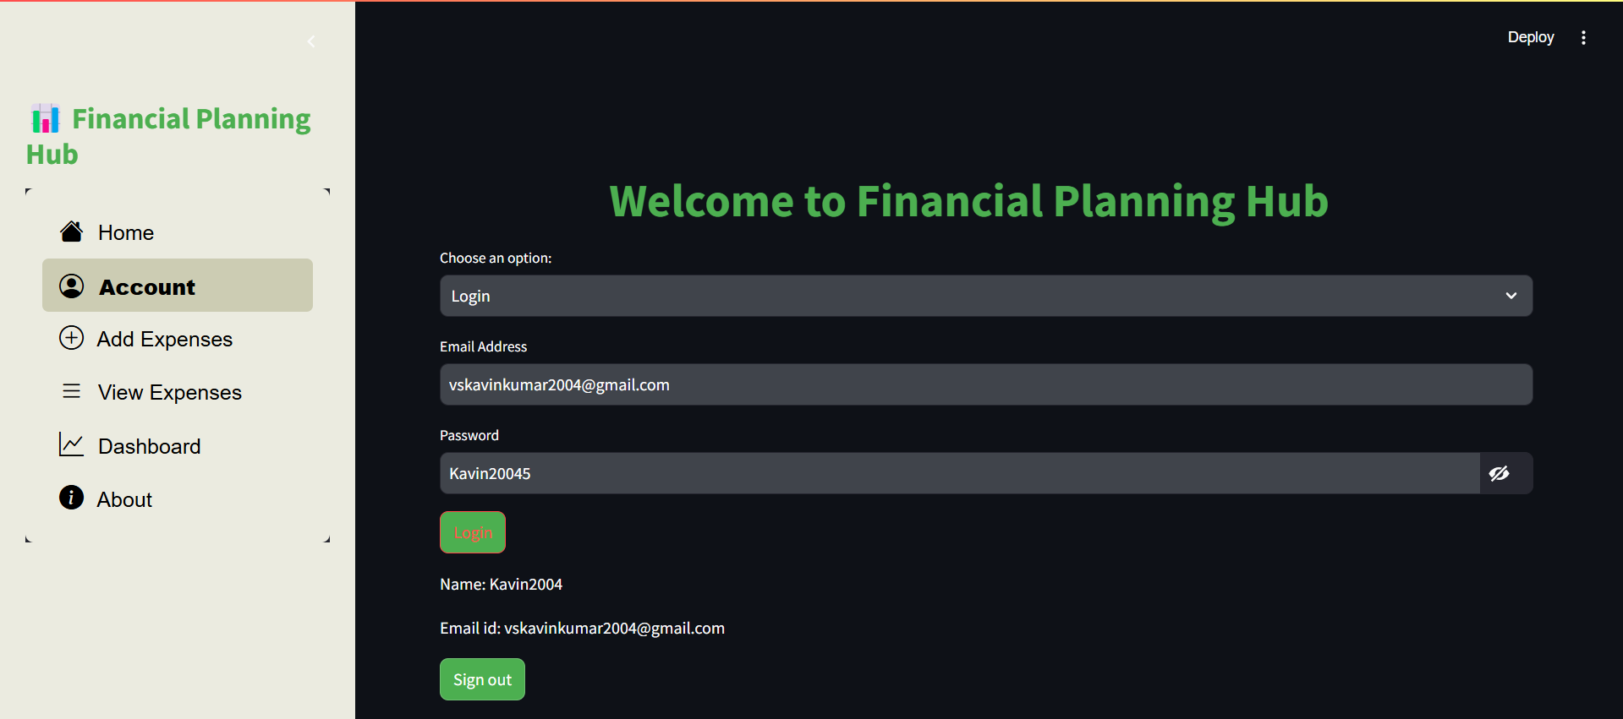
04
Project Snapshot
Account Page

Slide 10
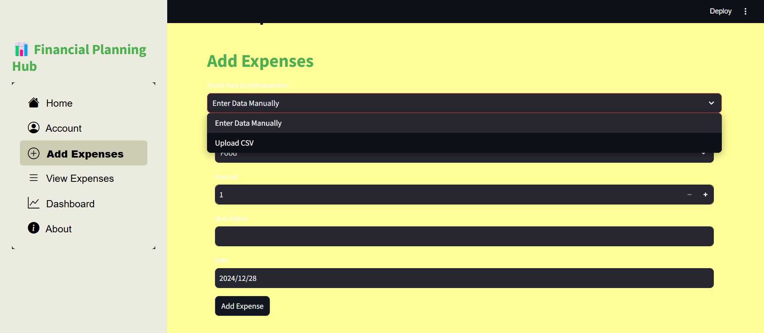
04
Project Snapshot
Add Expenses

Slide 11
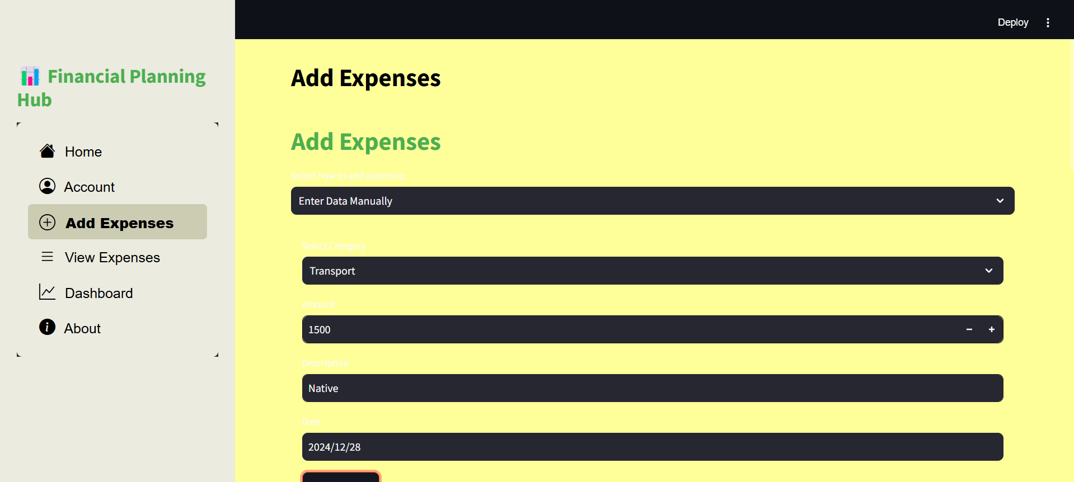
04
Project Snapshot

Slide 12
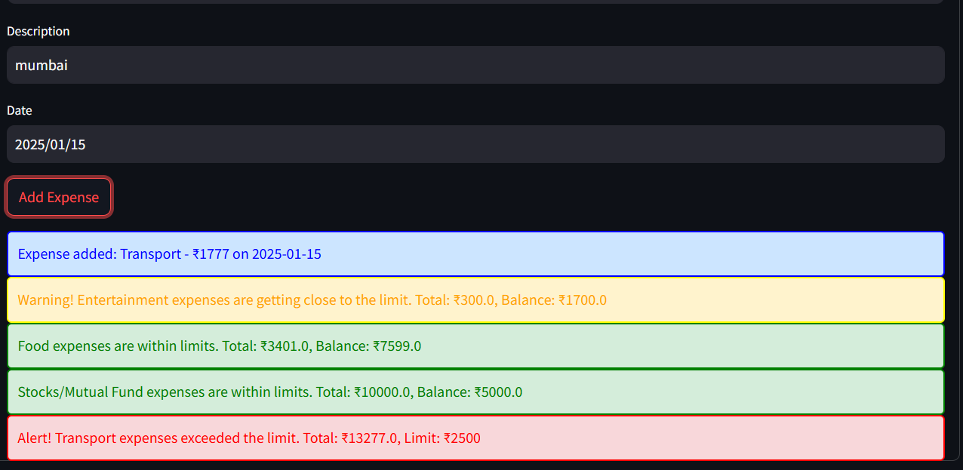
04
Project Snapshot

Slide 13
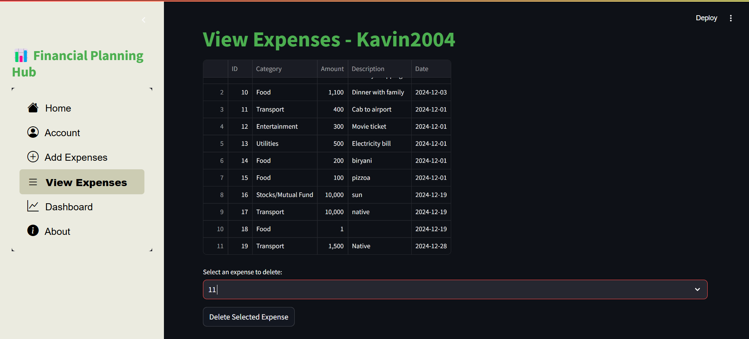
04
Project Snapshot
View Expenses

Slide 14
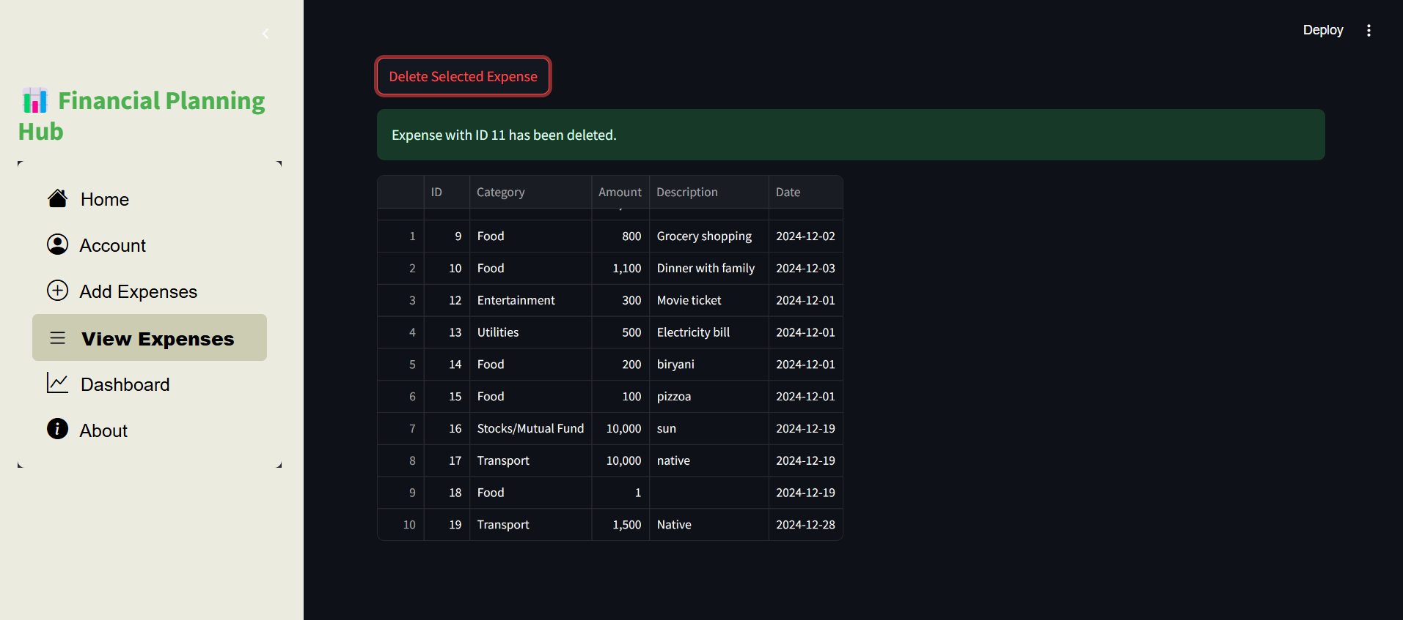
04
Project Snapshot

Slide 15
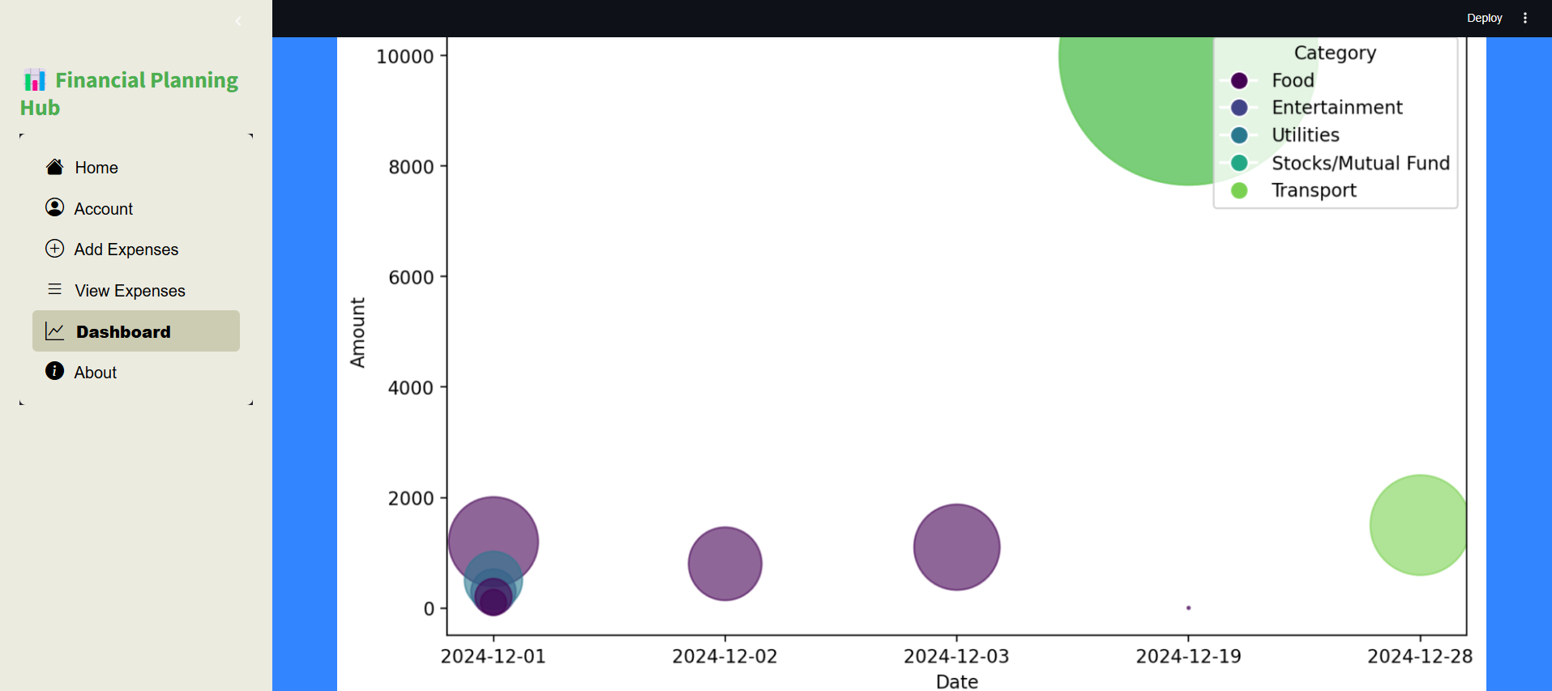
04
Project Snapshot
Dashboard

Slide 16
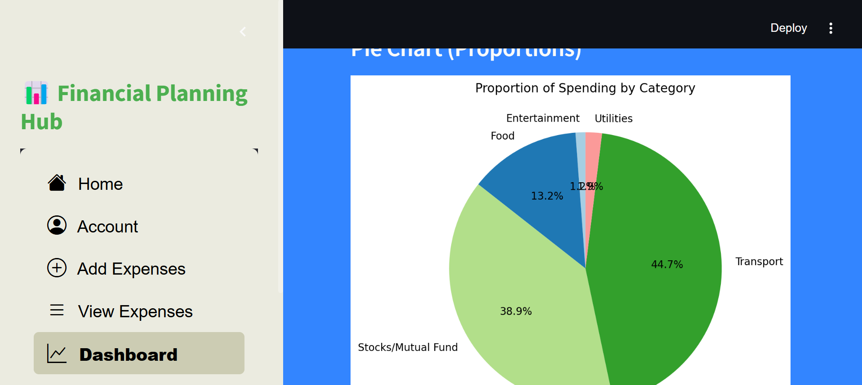
04
Project Snapshot

Slide 17
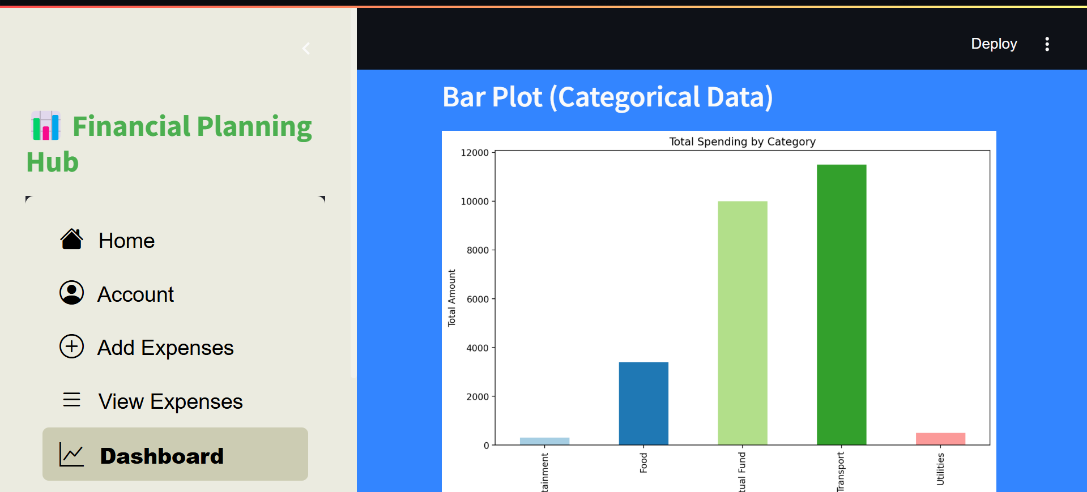
04
Project Snapshot

Slide 18
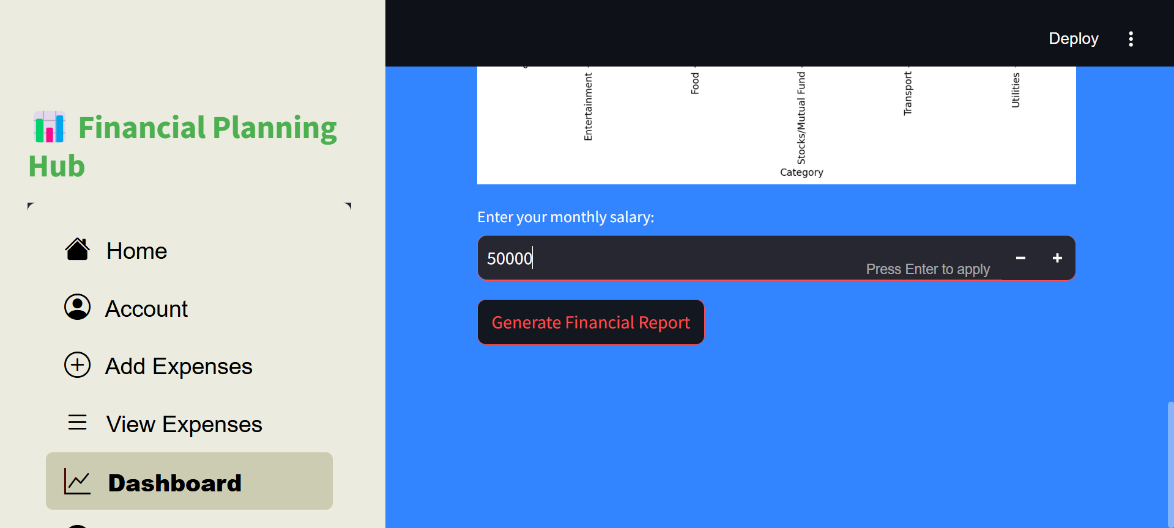
04
Project Snapshot

Slide 19
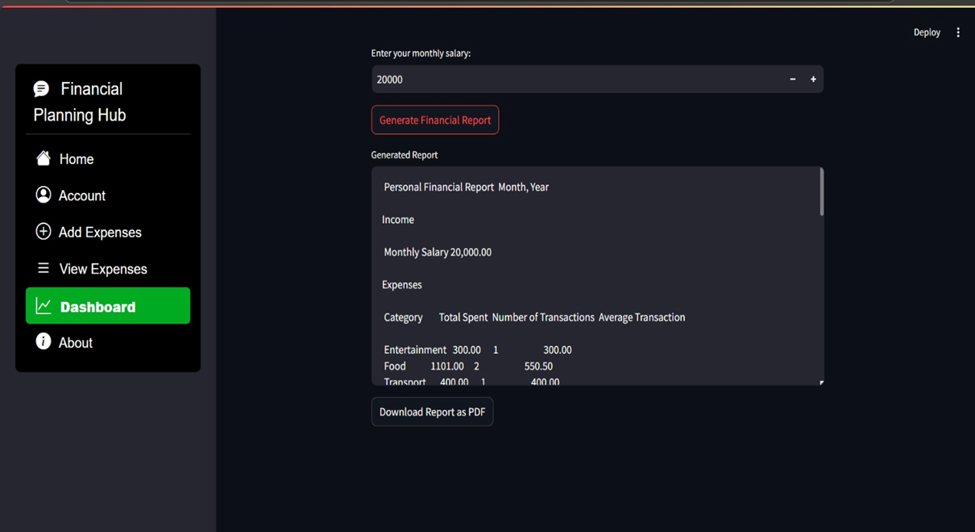
04
Project Snapshot

Slide 20
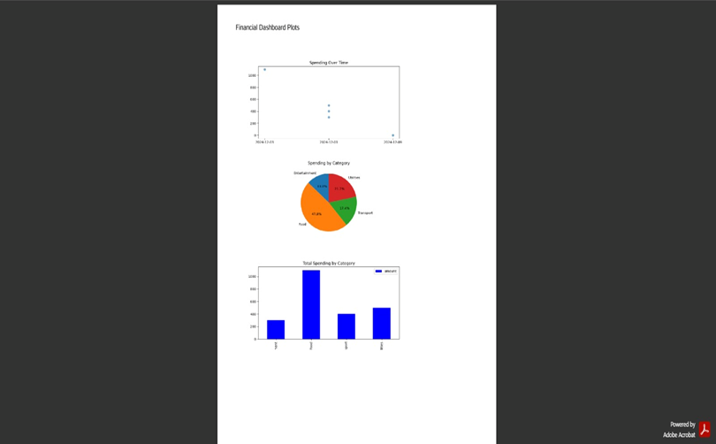
04
Project Snapshot
Report

Slide 21
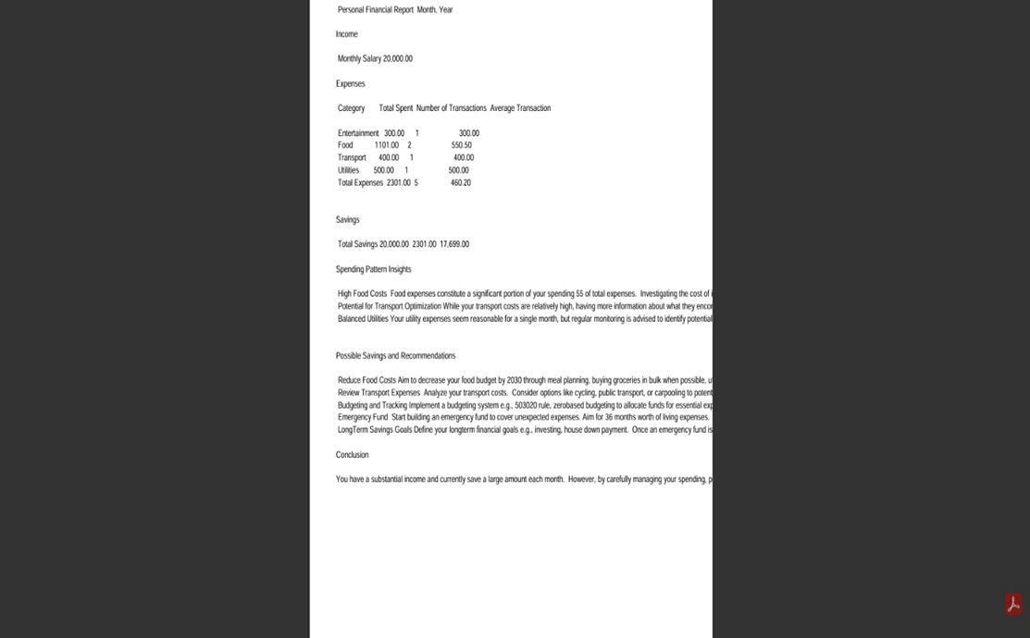
04
Project Snapshot

Slide 22
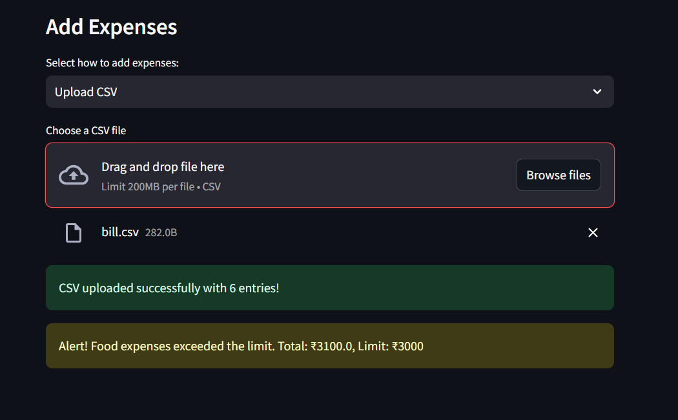
04
Project Snapshot
Budget Alert

Slide 23
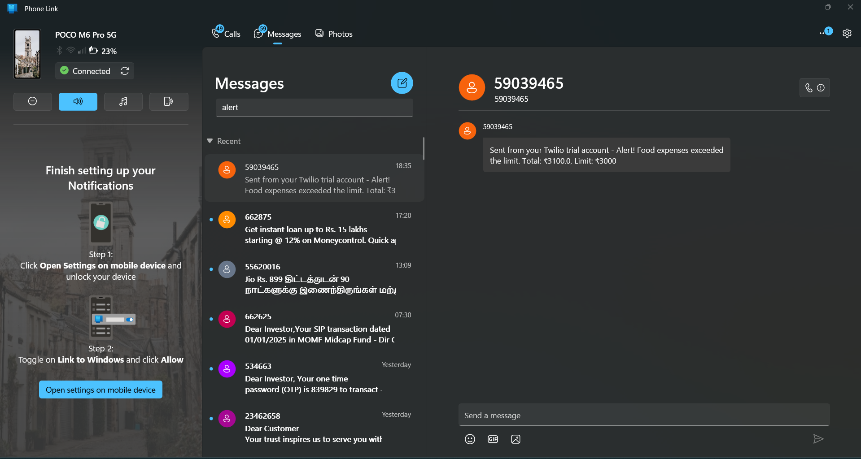
04
Project Snapshot

Slide 24
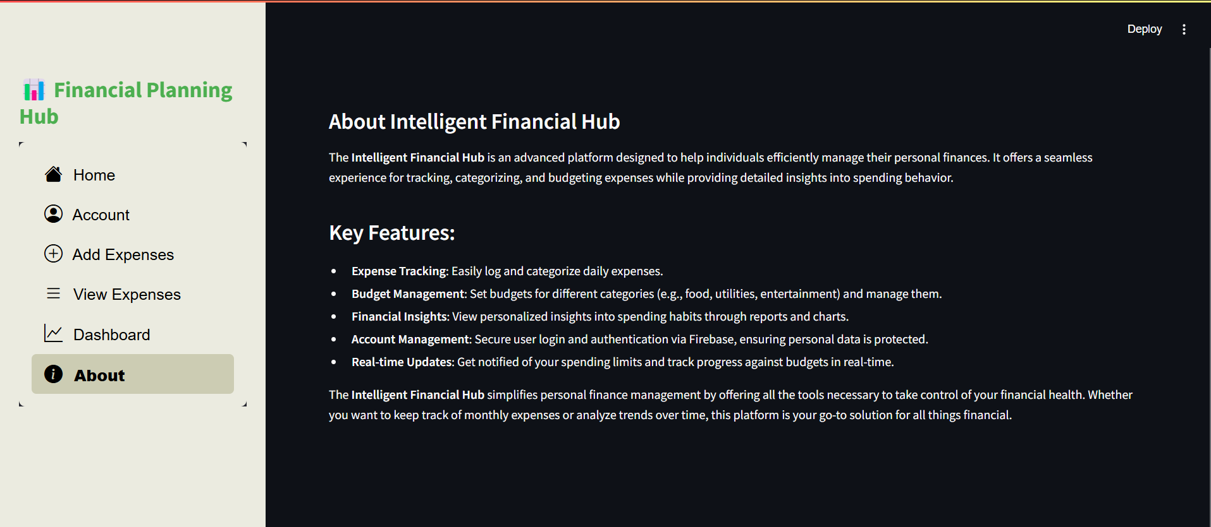
04
Project Snapshot
About Page

Slide 25
05
Conclusion
Personal Finance Tracker is a comprehensive and user-friendly solution for managing personal finances. It integrates secure authentication, efficient expense management, insightful financial reporting, and advanced budget planning features. The application empowers users to track spending, visualize trends, and achieve financial goals while ensuring a seamless experience with validations and robust testing. This project successfully addresses the need for effective financial management, offering practical tools for users and administrators alike.

Slide 26
Team Members
KavinKumar VS
JayanthRagavan M (Team Lead)

Slide 27

Thank
You

